Slide 1
Chapter – 2
Getting Started
Objectives:
At the end of this module, you would have gained fair knowledge on
The structure of a Linux system
Kernel & Shell
Login and Logout
Basic Linux Commands

Slide 2
Structure of a Linux System
USERS
Linux Shell
Application programs
(Word Processor, Spreadsheets, Web Browser, Games etc.)
Linux Kernel
Hardware Devices

Slide 3
Hardware Devices
In any computer system, the lower most layer is the hardware components (i.e. physical components like your mother board, hard disk drive, floppy drive, memory, etc.)
Kernel
When your system is booted, the Linux Kernel will be loaded into the memory (DRAM) of your system and after that the kernel will control the entire operation of your system. Only the Kernel can interact directly with the hardware. The Kernel will be available in the memory until you reboot the system.
Application Programs
Kernel alone cannot do much operation that you may have to perform on a computer system. That is why we are using application programs above the kernel. An application program may be a word processor, spreadsheet, image editor, music player, web browser, database software, etc.
Shell
Shell is an interpreter through which a user can interact with the kernel. Shell is a program or command, which will start whenever a user logs into the system. This is one of the powerful feature of Linux/Unix system. All the users in a Linux system will have their own shell running in the background.

Slide 4
Text base Login
A console (Non-GUI) login screen will look something similar as given below:
Red Hat Linux release 7.2 (Enigma)
Kernel 2.4.7-10 on an i686
localhost login: root
Password:
Welcome to Linux 2.4.7-10
root@local host root] #

Slide 5
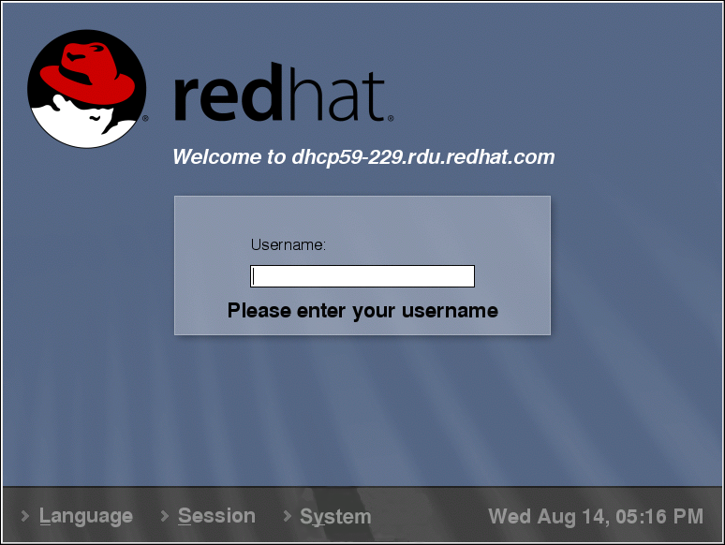
Graphical Login

Slide 6
Logout Process
After you have completed your work in a Linux system, you have to logout before leaving the system. If you leave the system without logging out, others can come and use the system and this may create a security problem in your network. There are different methods to logout from a Linux system. If you are not using a GUI you can use “exit” command to logout.
root@localhost root] # exit
Red Hat Linux release 7.2 (Enigma)
Kernel 2.4.7-10 on an i686
localhost login:root

Slide 7
Virtual Terminals
In the server you can have multiple login terminals (Virtual Terminals). By default, you will have six text base login terminals and one graphical login terminal. By pressing the CTRL+ALT+F1 – CTRL+ALT+F7 keys you can switch from one terminal screen to another. If your system is configured to start GUI automatically at the time of booting, you will be getting your GUI based login window at terminal 7.

Slide 8
Basic Linux Commands
Red Hat Linux has provided a set of commands for interacting with the system. Let us learn about the various commands available.
Command format
ls <options> <destination directory>
The ls command is used to list the contents of a file system or directory. ls command will support large number of options for customizing the output.
[manoj@localhost manoj]$ ls
The above command will list the content of the directory manoj on the terminal screen.
[manoj@localhost manoj]$ ls /etc/X11
The above command will be listing the contents of /etc/X11 directory on the screen. The other options used along with ls command are given below.

Slide 9
Basic Linux Commands
Options:
-a-List all the files including the hidden files ( files starting with . )
-l-Long listing – Will display the file permissions, ownership’s, file size and last modification time, etc. along with the file names.
-d-List the name of the directory instead of its content.
-R-Recursive listing – Will list out the content of all subdirectories.
-S-Sort by file size.
-t-Sort by modification time.
-u-Along with l option displays the last access time in place of modification time.
--help-Displays the help screen.

Slide 10
Use of Wild Cards
* matches all the characters including a null character.
? matches single character.
[ ] matches an array of characters.
! will use as inverse operator
[manoj@localhost manoj]$ ls [a-z]*
The above command will list out all the files starting with lower case.
[manoj@localhost manoj]$ ls [a-zA-Z]*
The above command will display all the files starting with any alphabet regardless of the case.
[manoj@localhost manoj]$ ls [!a-z]*
The above command will display all the file names that are not starting with lower case.

Slide 11
cat – Creating files
Command format
cat <operator> <file name>
The cat command can be used to create a file, append a file and for displaying the contents of a file. To create a file the cat command is used with a ‘>’ symbol
[manoj@localhost manoj]$ cat > accel.txt
Accel it academy
37, Nelson Manickam Road
Aminjikarai
Chennai – 29
<ctrl-d>
In the above example, if the file accel.txt already exists, the contents of that file will be overwritten.

Slide 12
[manoj@localhost manoj]$ cat accel.txt
Accel it academy
37, Nelson Manickam Road
Aminjikarai
Chennai – 29
<ctrl-d>
In the above example the cat command is used without any option to display the contents of a file. The cat command with a ‘>>’ operator is used to append the contents of the file specified.
[manoj@localhost manoj]$ cat >> accel.txt
Computer H/W and N/W
Solaris Administration
Linux Administration
Unix Administration
Windows 2000 Administration
<ctrl-d>
The above command will add whatever you type at the end of the file.

Slide 13
pwd – Print Working Directory
The pwd command can be used to display the full path of the present (current) working directory.
Command format
pwd
mkdir - Creating Directories
The mkdir command is used to create directories.
Eg : # mkdir test
Command format
mkdir <directory name>

Slide 14
cd – Navigating Through Directories
The cd command can be used to navigate through the directory structure of your Linux system.
[manoj@localhost manoj]$ cd test
[manoj@localhost test]$pwd
Command format
cd <directory name>

Slide 15
rmdir – Deleting Directories
Command format
rmdir <directory name>
The rmdir command is used to remove empty directories.
# rmdir test
The above command will remove the test directory, if it is empty.

Slide 16
rm – Deleting File
The rm command can be used to delete a single file or more than one files.
Command format
rm <options> files
[manoj@localhost test]$ rm accel.txt
The above command will delete the file accel.txt. Before deleting the file you will be prompted for a confirmation and the file will be deleted only if you give a positive reply.
[manoj@localhost test]$ rm –f Accel.txt
The –f option will delete the file without asking for confirmation.
[manoj@localhost test]$ rm –r aita
The –r option along with rm command can be used to delete a directory and its contents.
Wildcard characters can be used along with rm command as follows:

Slide 17
type – To find out the location of a command
The type command can be used to find out the exact location of a command.
[manoj@localhost manoj]$ type passwd
/usr/bin/passwd
The output of the above command shows that the passwd command is located in /usr/bin directory.
file – Type of the file
The file command can be used to check the type of a file.
Command Format
file <file name>

Slide 18
wc – The word count command
The wc command will count the number of lines, words and characters available in a file.
[aita@localhost aita]$ wc accel.txt
18 58 136 accel.txt
The output indicates that the accel.txt file contains 18 lines, 58 words and 136 characters in it.
Command Format
wc <options> filename
Options:
wc –lCount only the number of lines in a file
wc -wCount only the words in a file
wc –cCount only the characters in a file

Slide 19
mv – Moving and renaming
Command Format: mv file1 file2
The mv command is used to move or rename a file.
[aita@localhost aita]$ mv accel.txt aita.txt
The above command will rename the file accel.txt as aita.txt.
[aita@localhost aita]$ mv accel.txt /home/manoj/accel.txt
The above command will move the file accel.txt to /home/manoj directory.
cp – Copying Files
cp – Copying Files

Slide 20
cp – Copying Files
Command Format
cp <options> file1 file2
The cp command is used to copy one or more files from one location to another.
[aita@localhost aita]$ cp accel.txt aita.txt
The above command will create a duplicate copy of the file accel.txt as aita.txt in the same directory.
[aita@localhost aita]$ cp accel.txt /export/home
The above command will create a duplicate copy of the file accel.txt under the /export/home directory with the same name. You can use wild cards to copy more than one file using a single command line.
[aita@localhost aita]$ cp /aita/acc* /root/accel
The above command will copy all the files starting with acc from /aita subdirectory to /root/accel directory.
cp – Copying Files

Slide 21
Options:
cp –i Interactive copying. Prompt before overwriting a file
cp –l Link files instead of copying
cp –r Recursive copying. Copy the entire contents of directory including the subdirectories and its contents to the destination
cp –s Make symbolic links instead of copying

Slide 22
touch – Change the access & modification time of a file
[aita@localhost aita]$ touch accel.txt
The above command will set the current time as the last access time of the file accel.txt.
An empty file will be created if you have given a non-existing file name.
touch –a <file name> Change only the access time.
touch –m <file name> Change only the modification time.
touch –t yymmddhhmm <file name> To set the specified time stamp as the access and modification time of the file.

Slide 23
head – Display the top lines of a file
Command format
head options <file name>
The head command can be used to slize a file horizontally (line wise).
[aita@localhost root]# head /etc/passwd
The above command will display only the first 10 lines of the /etc/passwd file.
[aita@localhost root]# head –20 emp.lst
The above command will display the first 20 lines of the emp.lst file.

Slide 24
tail – Display the bottom lines of a file
The tail command can be used to display the last few lines of a file.
[aita@localhost root]# tail /etc/passwd
The above command will display the last 10 lines of the /etc/passwd file.
[aita@localhost root]# tail –15 /etc/passwd
The above command will display the last 15 lines of the /etc/passwd file.
Command format
tail options <file name>

Slide 25
cut – Cut a file vertically
The cut command can be used to cut a file vertically by character wise or column wise.
[aita@localhost aita]$ cut –c 1-4,10-15 data.txt
The –c option is used to cut a file character wise. The above command will display the 1st character through 4th character and 10th character through 15th character of all the lines of the file data.txt.
[aita@localhost aita]$ cut –d “|” –f 1,3,4 emp.lst
The –d option is used to cut a file field wise. The above command will display the 1st, 3rd, and 4th field of the emp.lst as output. Here the | symbol is used as the delimiter for separating one field from another.
Command format
Cut options <file name>

Slide 26
paste – Paste two files column wise
The paste command can be used to paste the content of one file with other file in column wise. Suppose we have two files called file1 and file2 the contents of both files is shown below.
[aita@localhost aita]# cat file1
ram
shyam
Deepak
Surya
# paste file1 file2
aita ram
icim shyam
astl Deepak
apls Surya
Command format
paste file1 file2
[aita@localhost aita]# cat file2
aita
icim
astl
apls

Slide 27
sort – Sorting the content of a file
Command format
sort options <file name>
The sort command can be used to sort the contents of a file in alphabetical order or in ascending order or in descending order.
[aita@localhost aita]# sort /root/test.db
The above command will sort the contents of test.db file in alphabetical order.
[aita@localhost aita]# sort –n /root/test.marks
The –n command is used to sort a file which contains numerical values.

Slide 28
grep – Searching for a string
The grep command can be used to display the records (lines) of a database that contains a particular string.
[aita@localhost aita]# grep “manager” /root/emp.lst
The above command will display all the lines which contains the string manager from the /root/emp.lst file.
[aita@localhost aita]# grep –v “manager” /root/emp.lst
The –v option will just inverse the result of grep command. In the above command, all the lines of /root/emp.lst file will be displayed except the lines that contain the string “manager”.
[aita@localhost aita]# grep –i “Manager” /root/emp.lst
The –i option is used to switch off the case sensitivity of grep command.
Command format
grep options <file name>

Slide 29
aspell – Checking the spelling
[aita@localhost aita]# aspell –c course.db
The aspell command is used to check spelling mistakes. This command will point out the suspicious words and give some choices. You can select the correct word from the give choices.
Command format
aspell –c <file name>

